Slide 1

PRIVATE EQUITY IN INDIA
By Niharika Chahar

Slide 2
Alternative Investment Fund
Alternative Investment Fund or AIF means any fund established or incorporated in India which is a privately pooled investment vehicle that collects funds from sophisticated investors, whether Indian or foreign, for investing it in accordance with a defined investment policy for the benefit of its investors.
AIFs are private funds that are otherwise not coming under the jurisdiction of any regulatory agency in India.

Slide 3
Categories of AIFs
Category I: Mainly invests in start-ups, SMEs, or any other sector which Govt. considers economically and socially well-grounded.
Examples: Venture capital funds (Including Angel Funds) o SME Funds o Social Venture Funds o Infrastructure funds.
Category II: These include Alternative Investment Funds such as private equity funds or debt funds for which no specific incentives or concessions are given by the government or any other Regulator.
Examples: Real estate funds, private equity funds (PE funds), funds for distressed assets, etc.
Category III: Alternative Investment Funds such as hedge funds or funds that trade with a view to making short-term returns or such other funds which are open-ended and for which no specific incentives or concessions are given by the government or any other Regulator.
Examples: Hedge funds, PIPE Funds, etc.

Slide 4
PRIVATE EQUITY
Private equity describes investment partnerships that buy and manage companies before selling them.
Private equity firms operate these investment funds on behalf of institutional and accredited investors.
Most private equity money comes from institutional investors, such as pension funds, sovereign wealth funds, endowments, and insurance companies.
High-net-worth individuals also invest directly or through fund-of-funds intermediaries.
Its aim is to improve the company's operations, increase its value, and sell it for a profit.
It involves investing in privately held companies or acquiring public companies and delisting them.

Slide 5
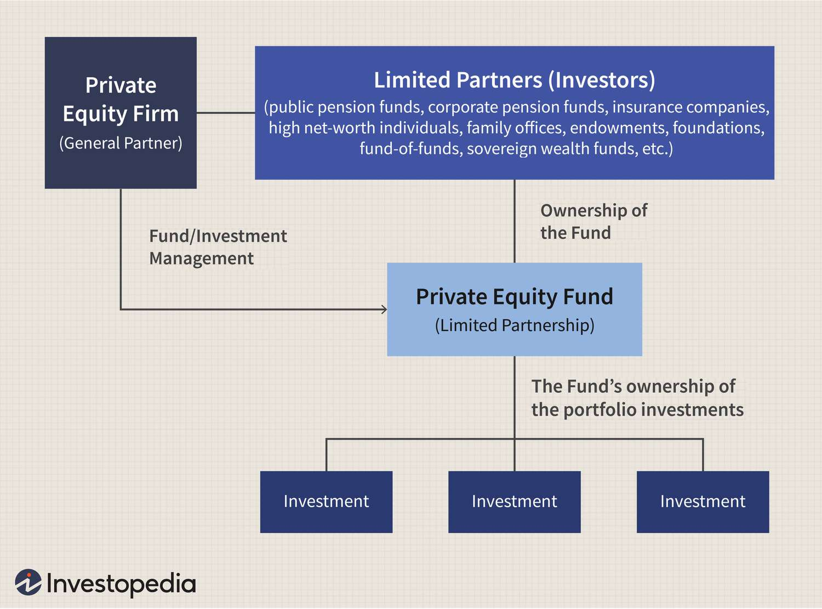
PE FUND STRUCTURE

Slide 6
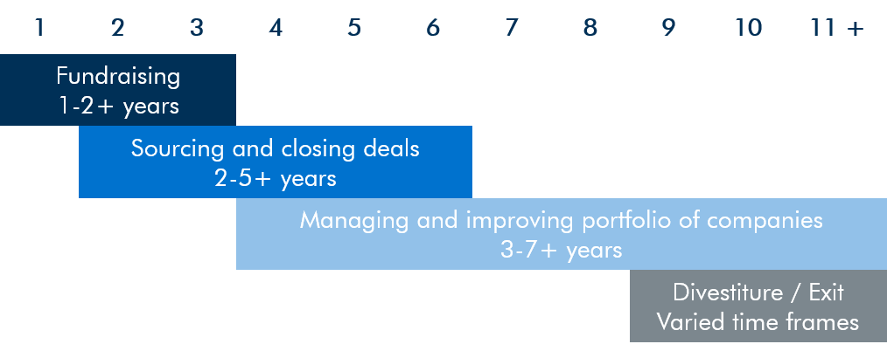
Life-cycle of Private Equity:

Slide 7
Explanation:
Formation(<2 years):
General Partners develop the fund's strategy and raise money from Limited Partners. Potential target companies are found.
Investment(2-5 years):
Fund invests in its core portfolio companies after a lot of due diligence.
Harvesting(3-7 years):
No new investments are made.
During the hold period, which typically lasts 3-7 years, the acquirer creates value by driving process transformation, optimizing operations, and maximizing the financial performance of the portfolio company before positioning the business for an exit.
In this stage, PE firms leverage their experience and networks to refine the acquired company’s strategy and grow through improved risk controls, functional processes, operational infrastructure, and human capital development.
Funds return(7-10 years):
Funds are returned to LPs with profits.
Whether it be through a trade sale, secondary buy-out, or IPO, the exit is where most of the investment return is generated. The proper timing and structure for the exit are vital to maximizing the return.

Slide 8
BAIN CAPITAL:
In 2002, former Bain & Company partners founded Bain Capital as a private partnership focused on deploying management consulting strategy to private equity investing.
Since its founding, Bain Capital has remained highly aligned with its limited partners and grown to become one of the world’s largest private, multi-asset investing firms. Bain Capital is a private, employee-owned company.
Bain Capital, LP is one of the world’s leading private investment firms with approximately $165 billion of assets under management.
The company is headquartered at 200 Clarendon Street in Boston with 22 offices in North America, Europe, Asia, and Australia.
Bain Capital India Office is in Mumbai, Maharashtra.
First Indian office of Bain Capital was established in 2007 in Mumbai.

Slide 9
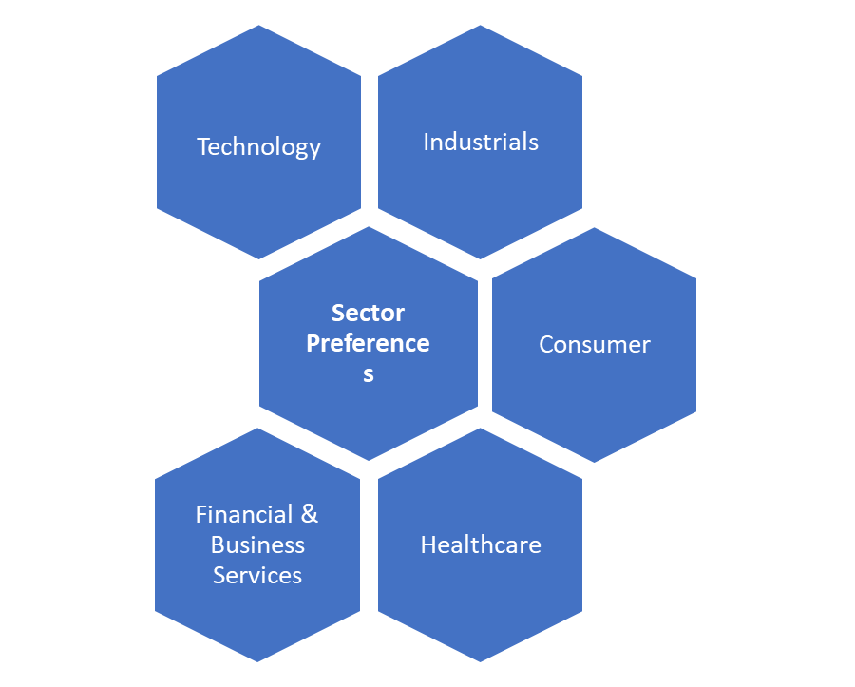
Sector Preferences of Bain Capital:

Slide 10
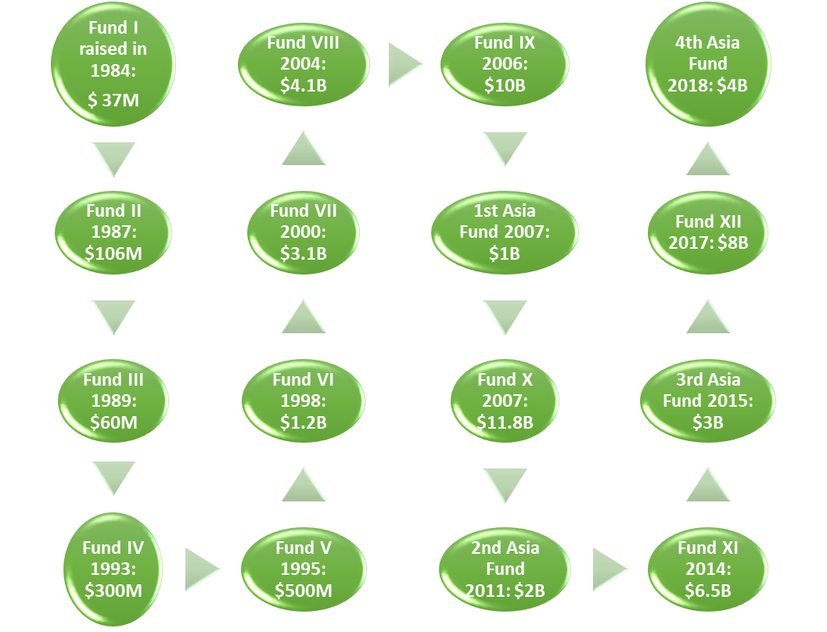
Funds raised from 1984 till now

Slide 11
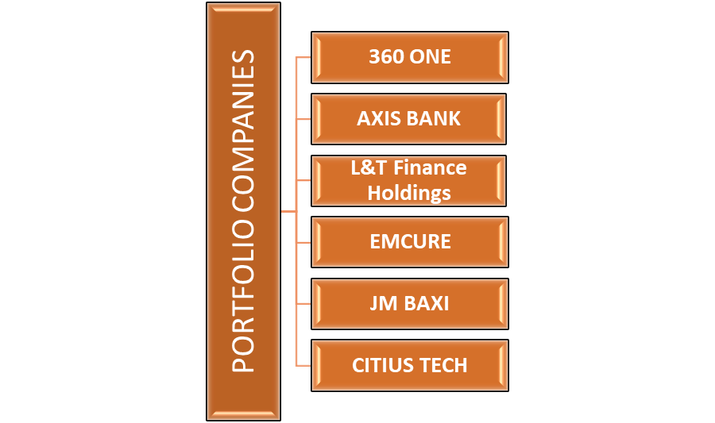
Indian Portfolio Companies of Bain Capital:

Slide 12
Entry strategy:
Company | Domain | Investment Amount | Stake | Year | Entry Strategy
360 ONE | Fintech | $485.6 million | 24.98% | March, 2021 | Funds of funds
Axis Bank | Bank & Financial Services | $1.8 billion | 4.24% | December, 2017 | Growth Capital
EMCURE | Pharma | $1 billion (approx) | 13.09% | December, 2013 | Funds of Funds
JM Baxi | Infrastructure | around $315 million | 35% | June, 2022 | Mezzanine Financing
Citius Tech | Information Technology | Around $1 Billion | 80% | October, 2019 | Buyout
L&T Finance Holdings | Bank & Financial Services | Around $200 million | 10.2% | 2015

Slide 13
Exit strategy:
Company | Domain | Partial/Full | ROI | Year | Exit Strategy
Axis Bank | Bank & Financial Services | Partial |  | 2022 | IPO
EMCURE | Pharma | Partial
JM Baxi | Infrastructure | Full |  | 2015
Hero MotoCorp | Automotive | Partial |  | 2014
L&T Finance Holdings | Bank & Financial Services | Partial |  | 2017

Slide 14
Domain:
Company | L0 | L1 | L2 | L3
360 ONE | Fintech | Digital Lending/ Financing | P2P | Consumer Business
Axis Bank | Bank & Financial Services | By Type | Scheduled Commercial | Private Sector
EMCURE | Pharma | Drugs/ Medicines | By Formulation By Formulation By Drug Type By Consumption Mode | Generic Branded OTC Prescription Oral Injection Inhalation Analgesic/Tubes/Ointment
JM Baxi | Infrastructure | Transportation | Marine Ports & Services
Citius Tech | Information Technology | IT Services | IT Consulting | Technology Data & Analysis Business
L&T Finance Holdings | Bank & Financial Services | By Type | Scheduled Commercial | Private Sector

Slide 15
THANK YOU

